Slide 1
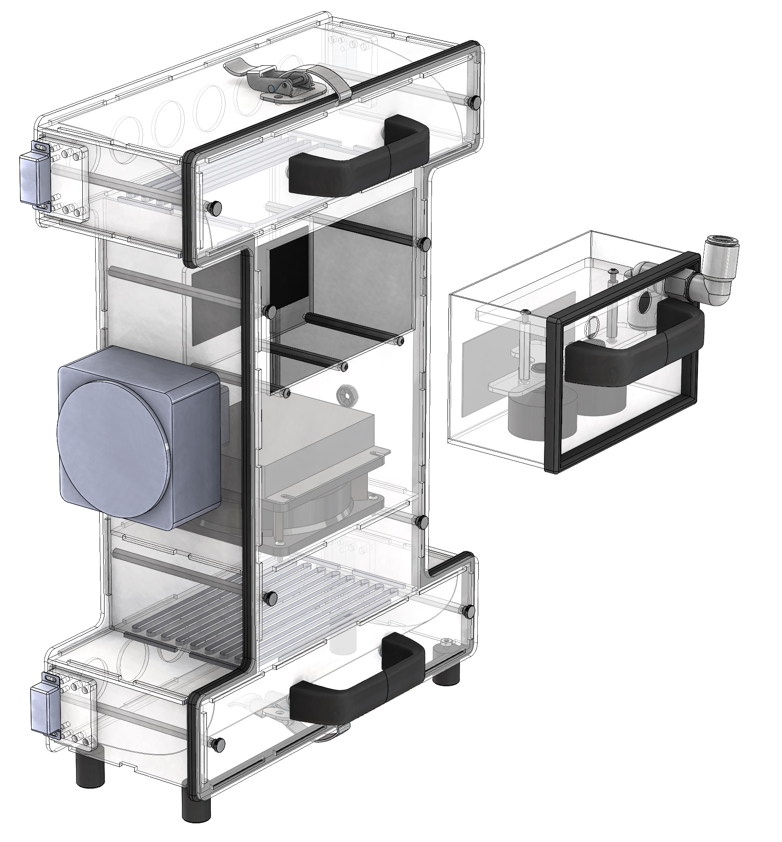
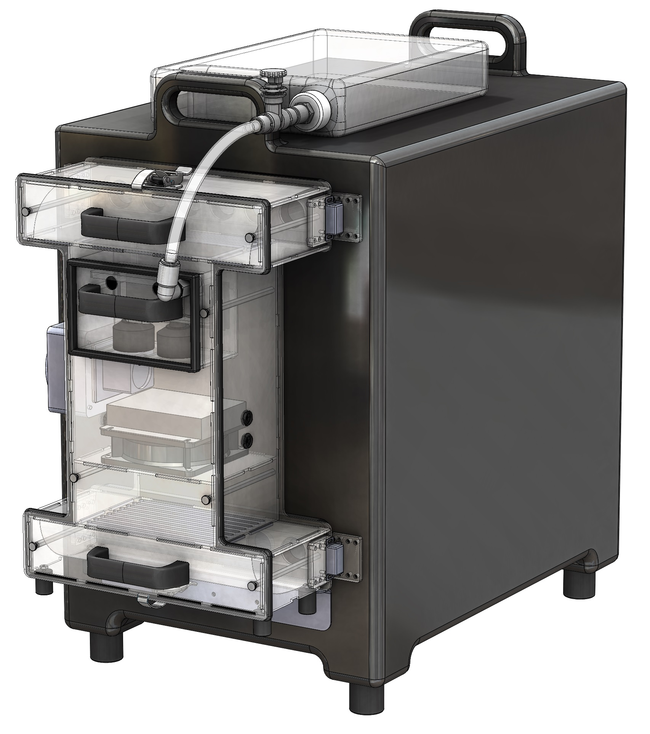
Fermentabot
Small-scale, digitally controlled fermentation for upcycling of food waste

Slide 2
Fermentabot Project Overview
Mechanical Specifications and Requirements
Housing and storage
Insulated food storage box and perforated food pans/cotton cloth
An “Environmental Chamber”
A device that can be attached/removed from the catering box and contains all the mechanical actuators such as heaters and fans.
Air circulation heating/cooling system
12V Peltier Cooler
12V heating element
12V equipment-cooling fan
Humidification system
External humidification cartridge
Miniature ultrasonic fogging technology
Control System
Humidity and temperature control

Slide 3
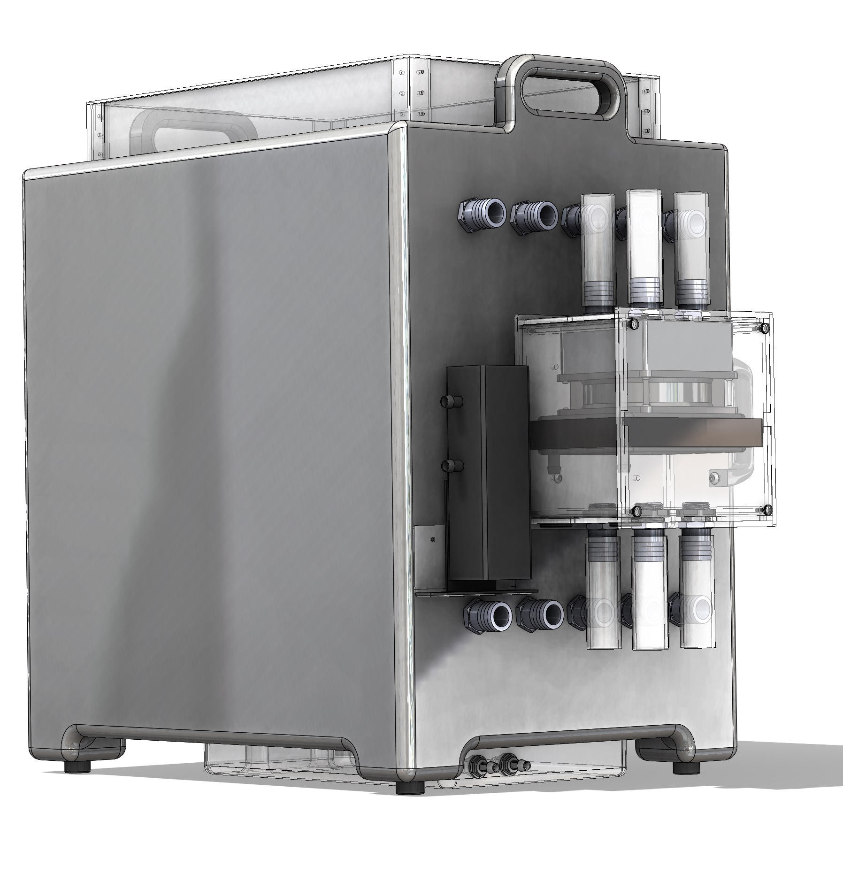
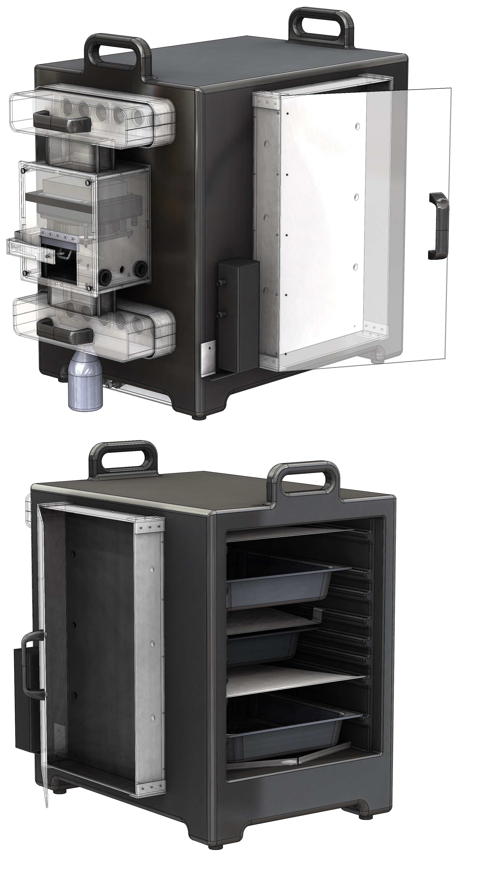
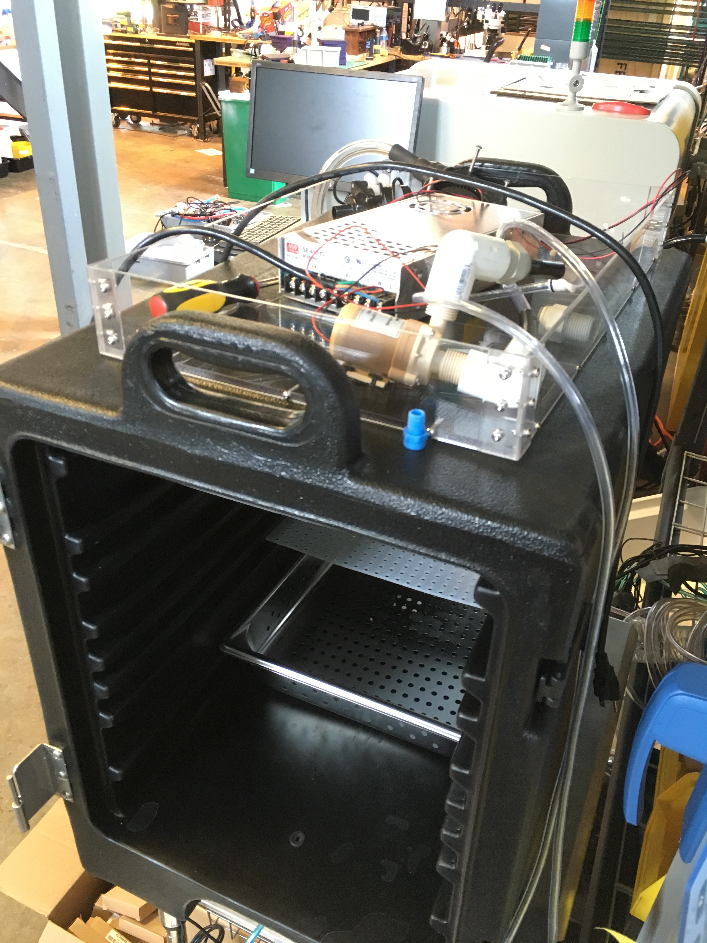
Design Progress
Initial designs considered water heater/chillers for controlling ambient temperature
External enclosures were considered for any onboard electronics/power supplies
Off-the-shelf components were to be used whenever possible
OpenAg already had inventory of heating units, fans, tubing, chillers, pumps etc. for rapid prototyping

Slide 4
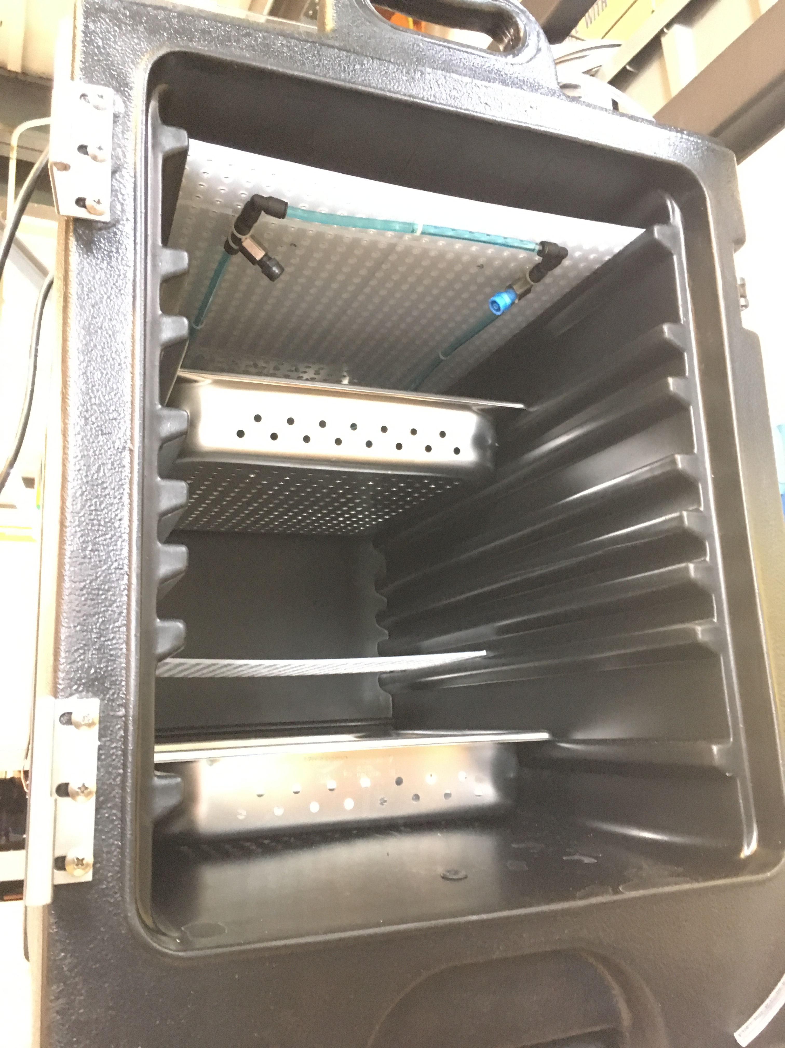
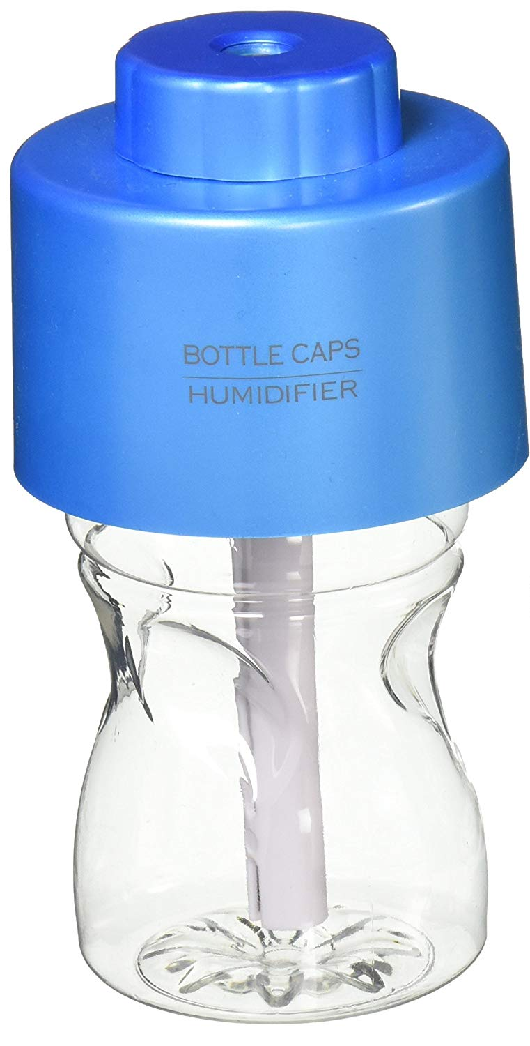
Humidification Testing and Prototyping – Early Stage
The goal was to use various off-the-shelf humidification solutions
Pressurized water through spray nozzles created too much direct condensation on the koji cloth
Bottlecap humidifiers did not provide enough moisture to the system
Iterative testing led to the selection of an ultrasonic fogger

Slide 5
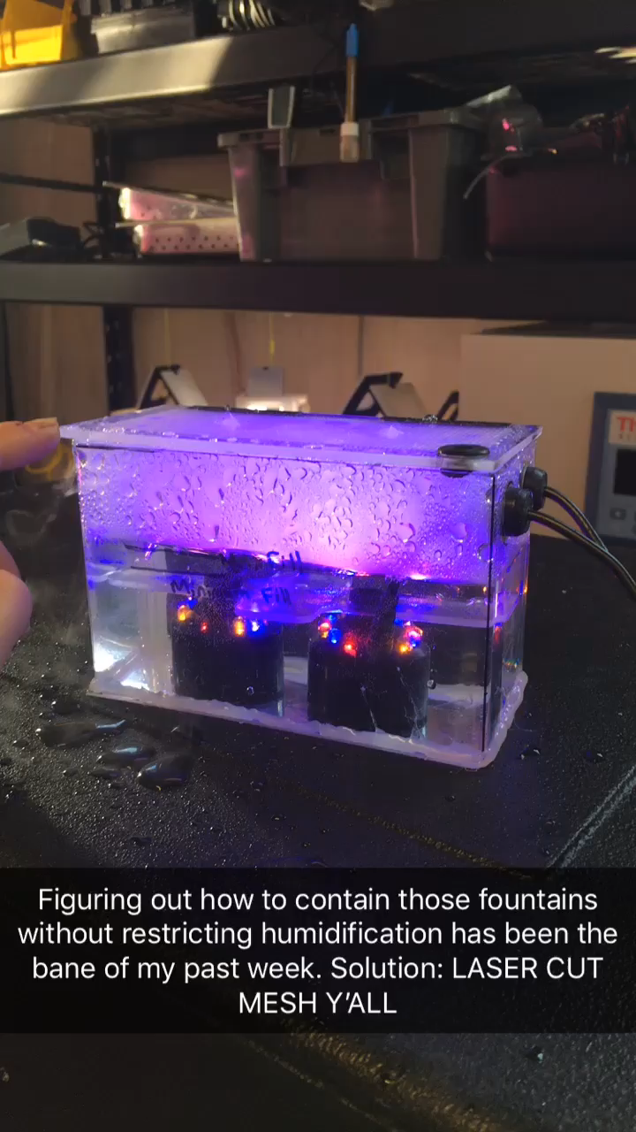
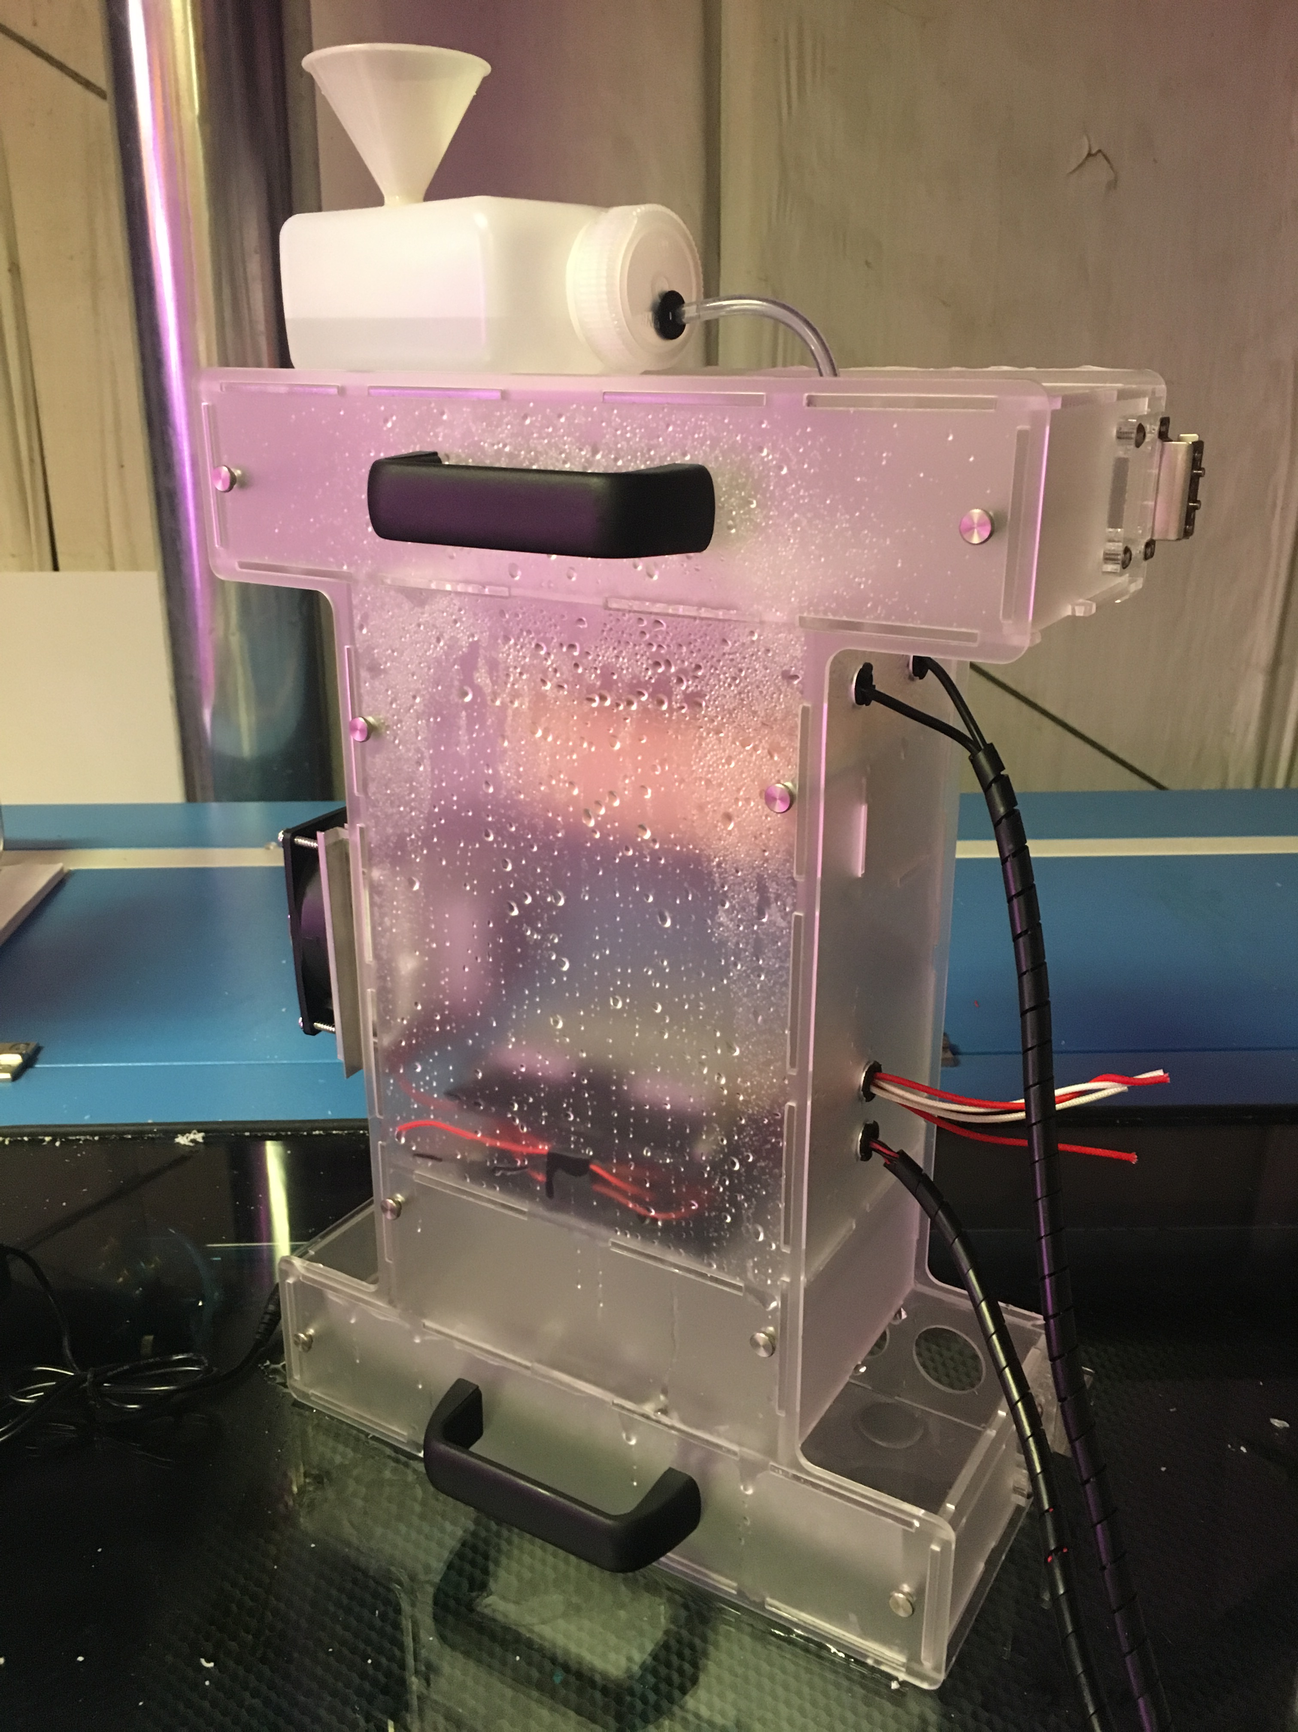
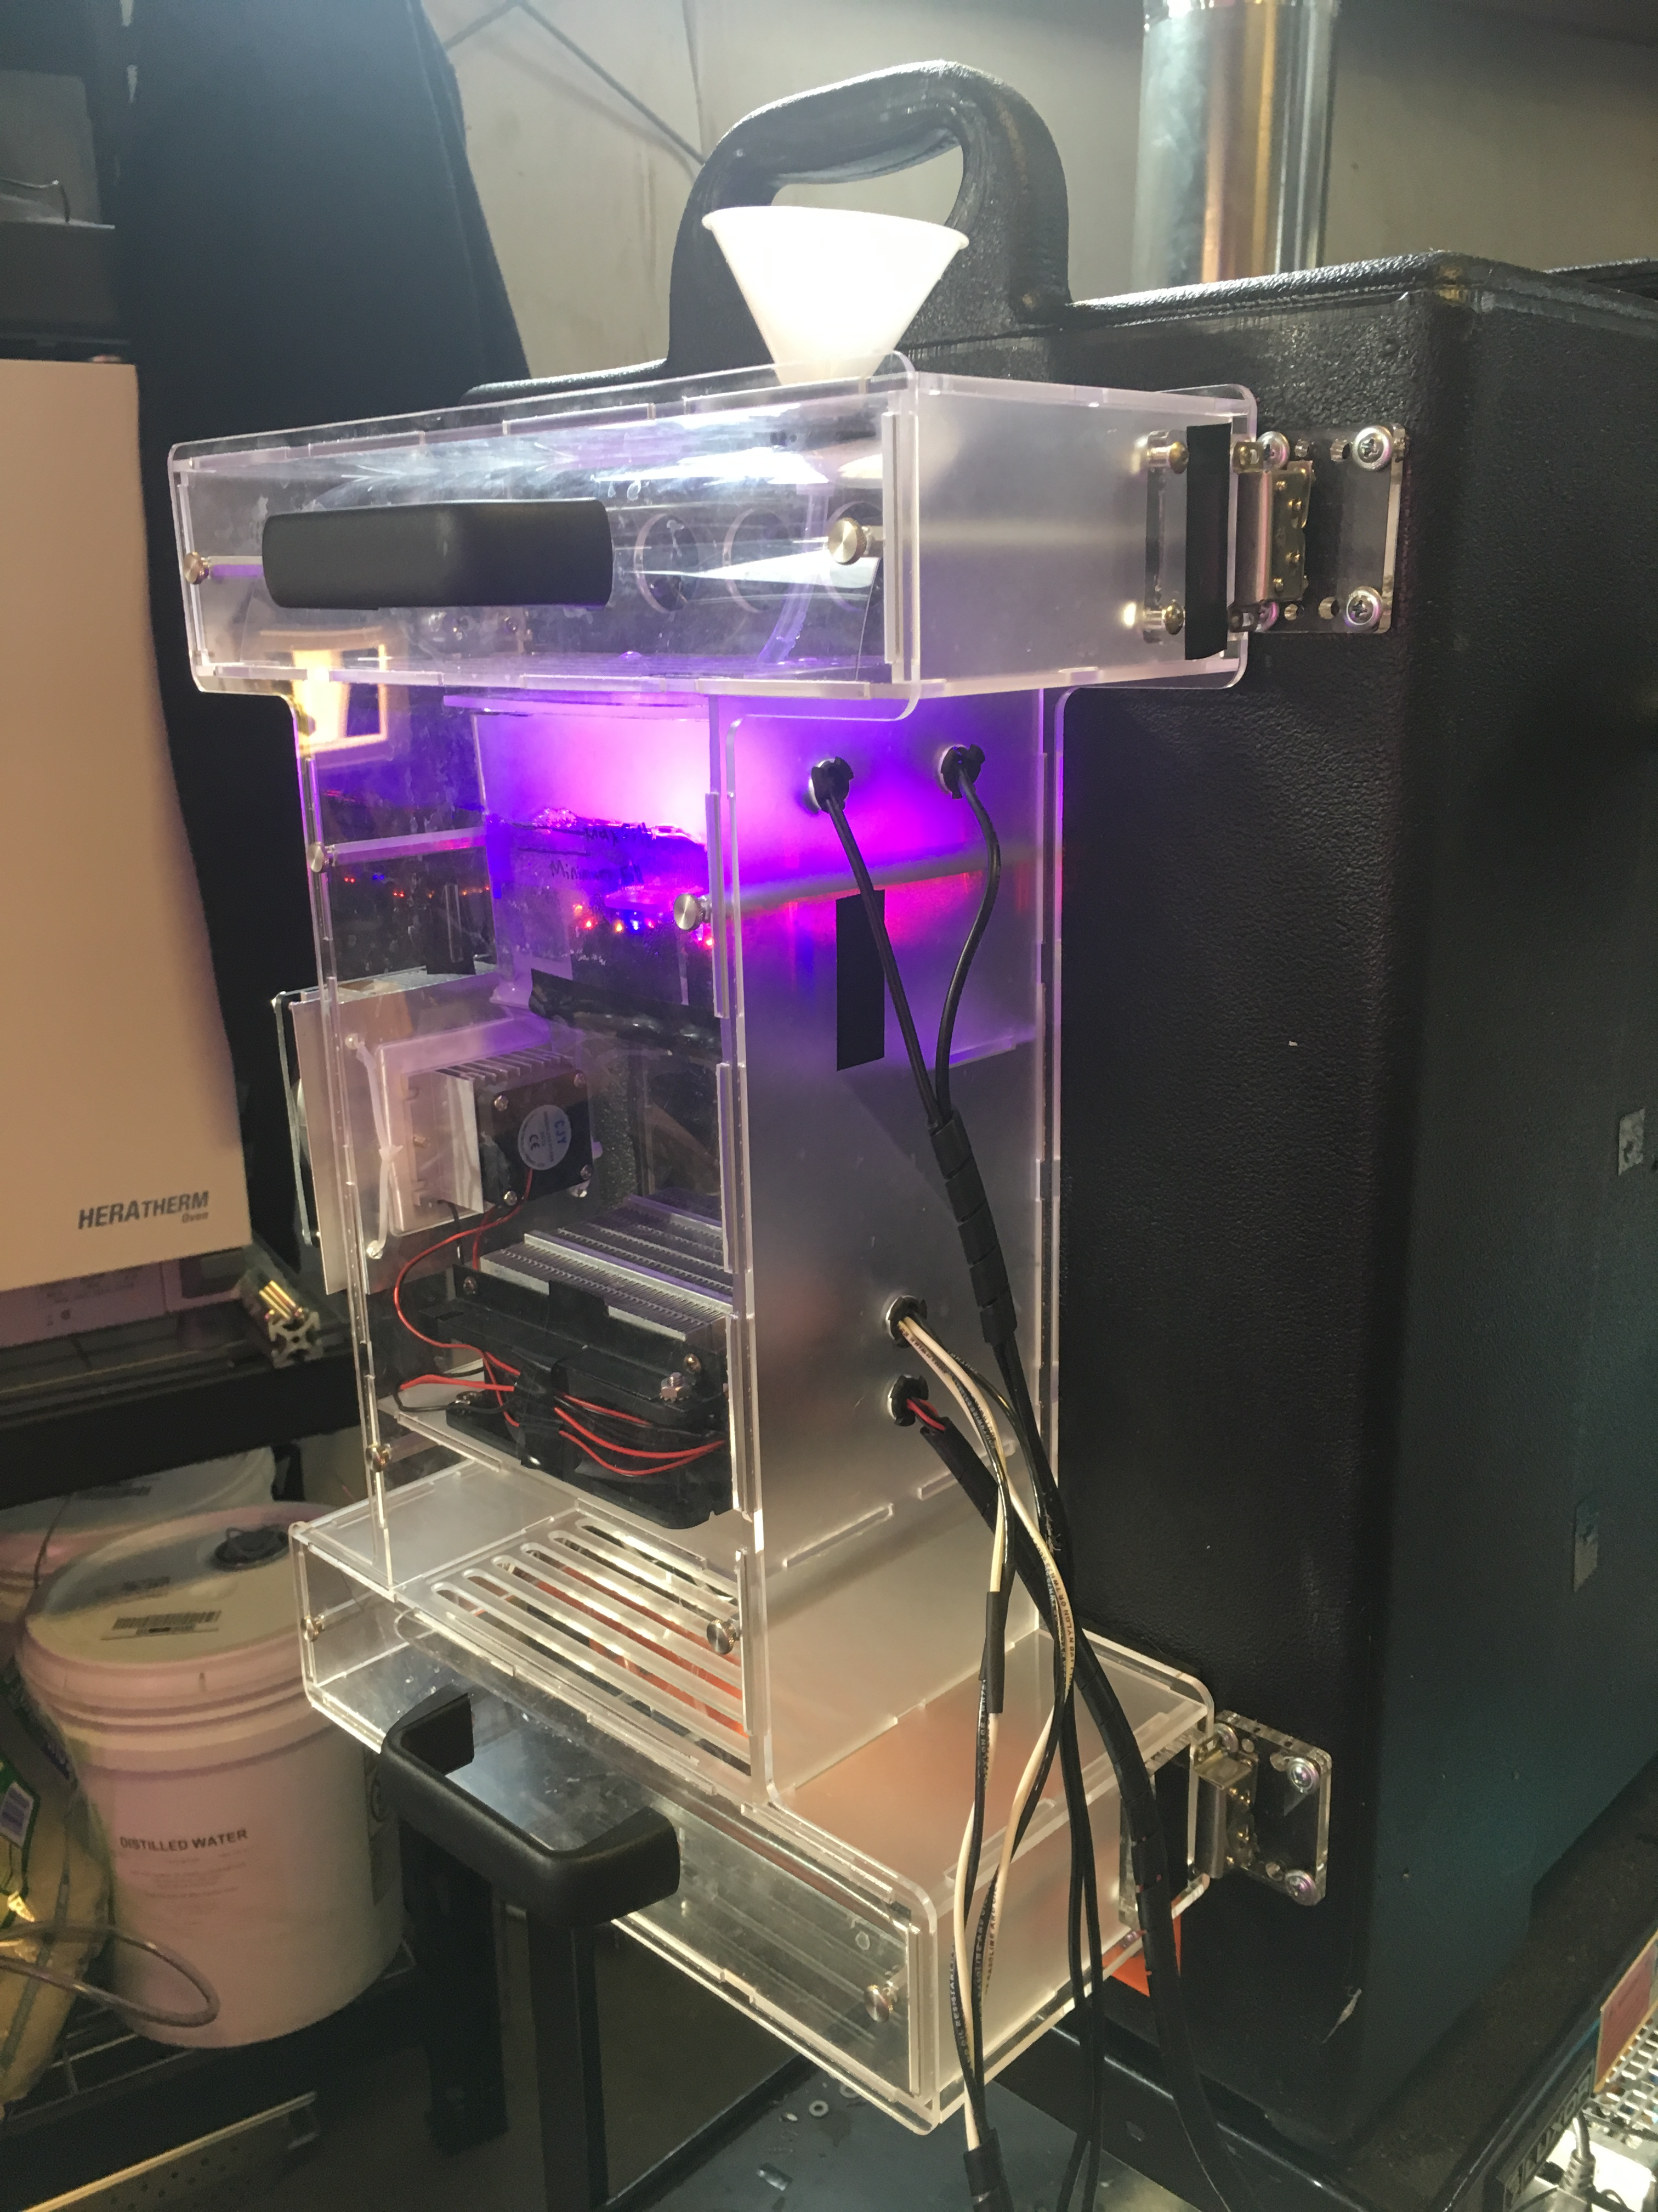
Humidification Testing and Prototyping
Final selection: FITNATE Ultrasonic Mist Maker
Environmental Chamber design necessitated a combination of off-the-shelf and custom solutions
Various designs were considered for integrating the humidifier and controlling humidity levels
Testing showed that two units were necessary to reach required humidity levels

Slide 6
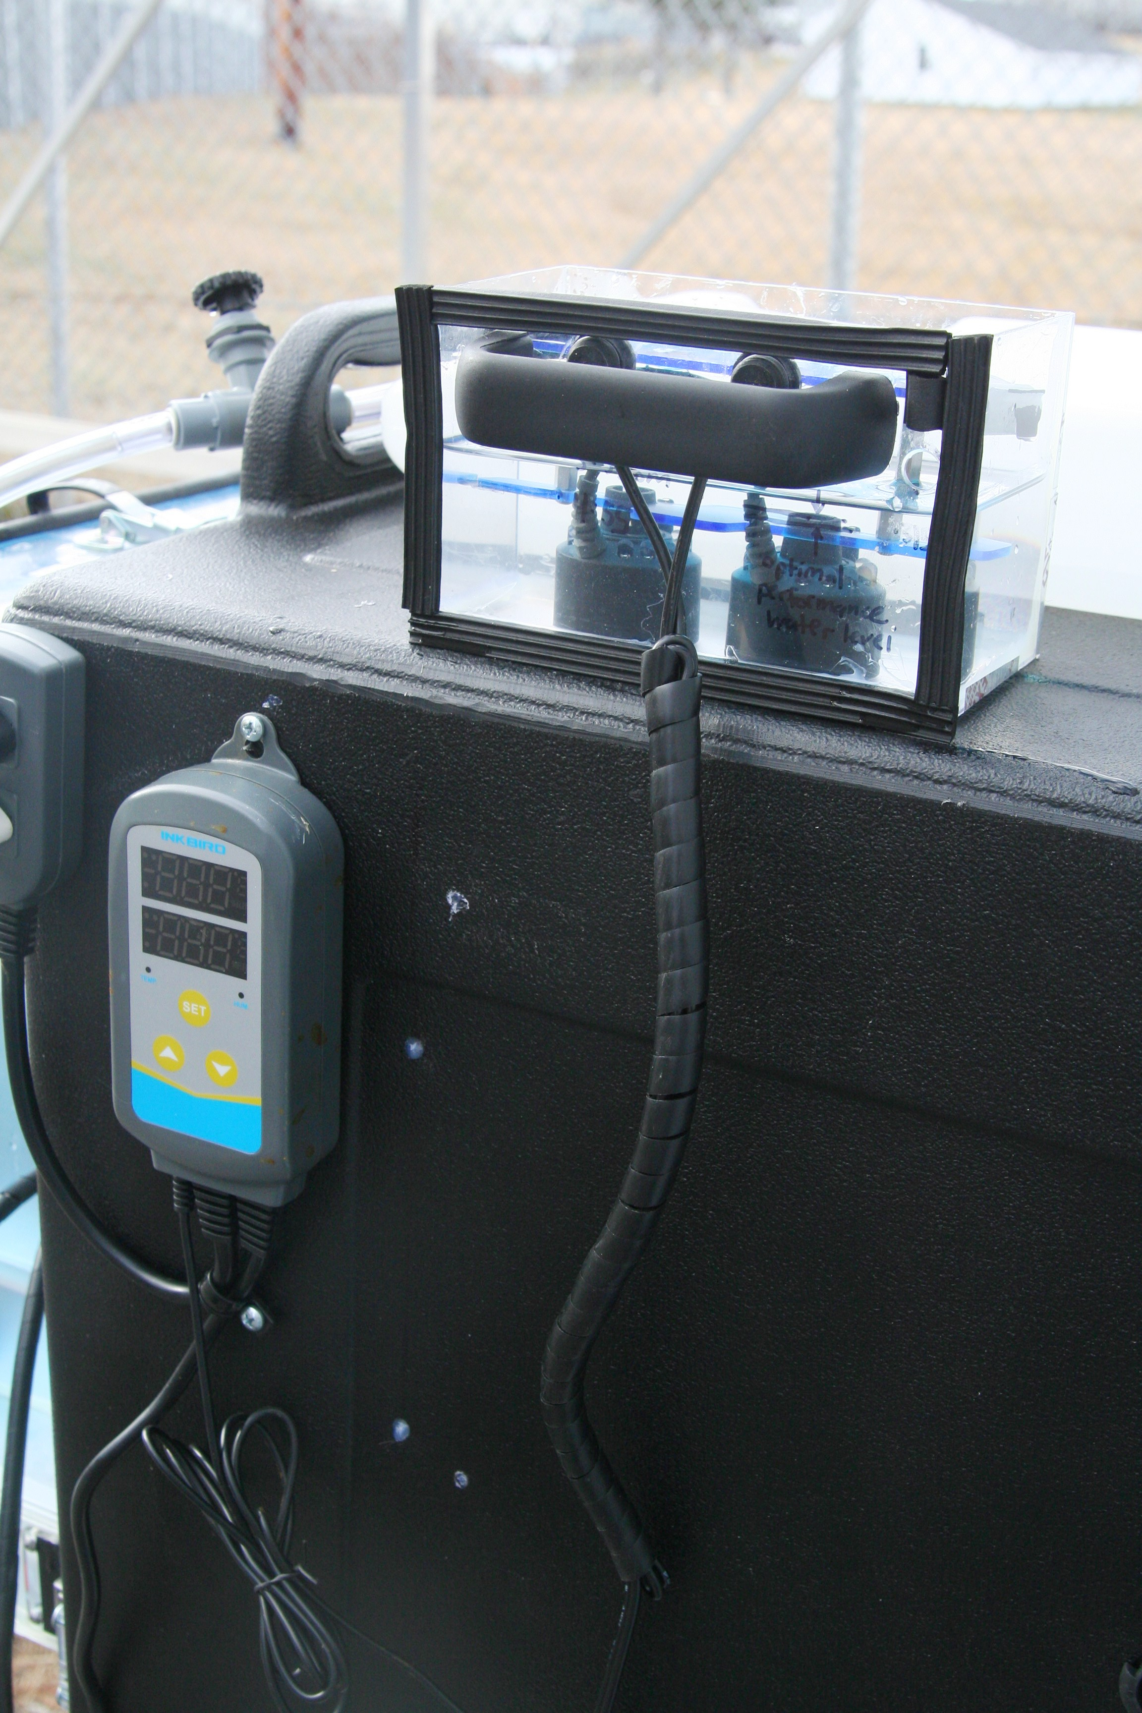
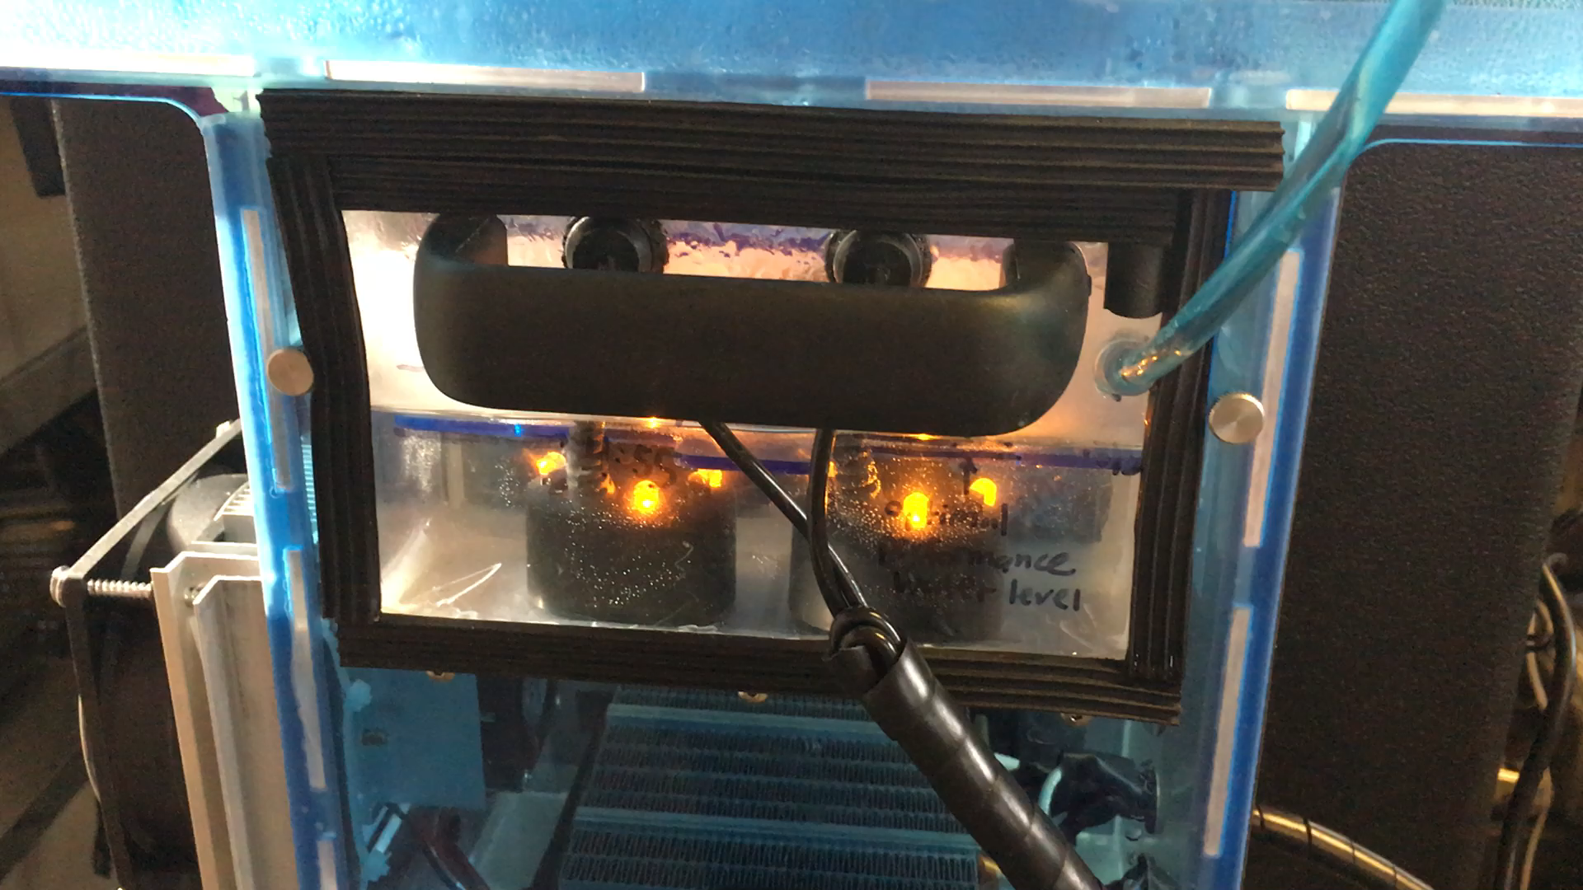
Humidification Testing and Prototyping
Humidifier was integrated into Environmental Chamber so that it could be removed for maintenance and refilled automatically
Water use approximates 1 mL/min, or 2.2 L over the course of a 36hr fermentation

Slide 7
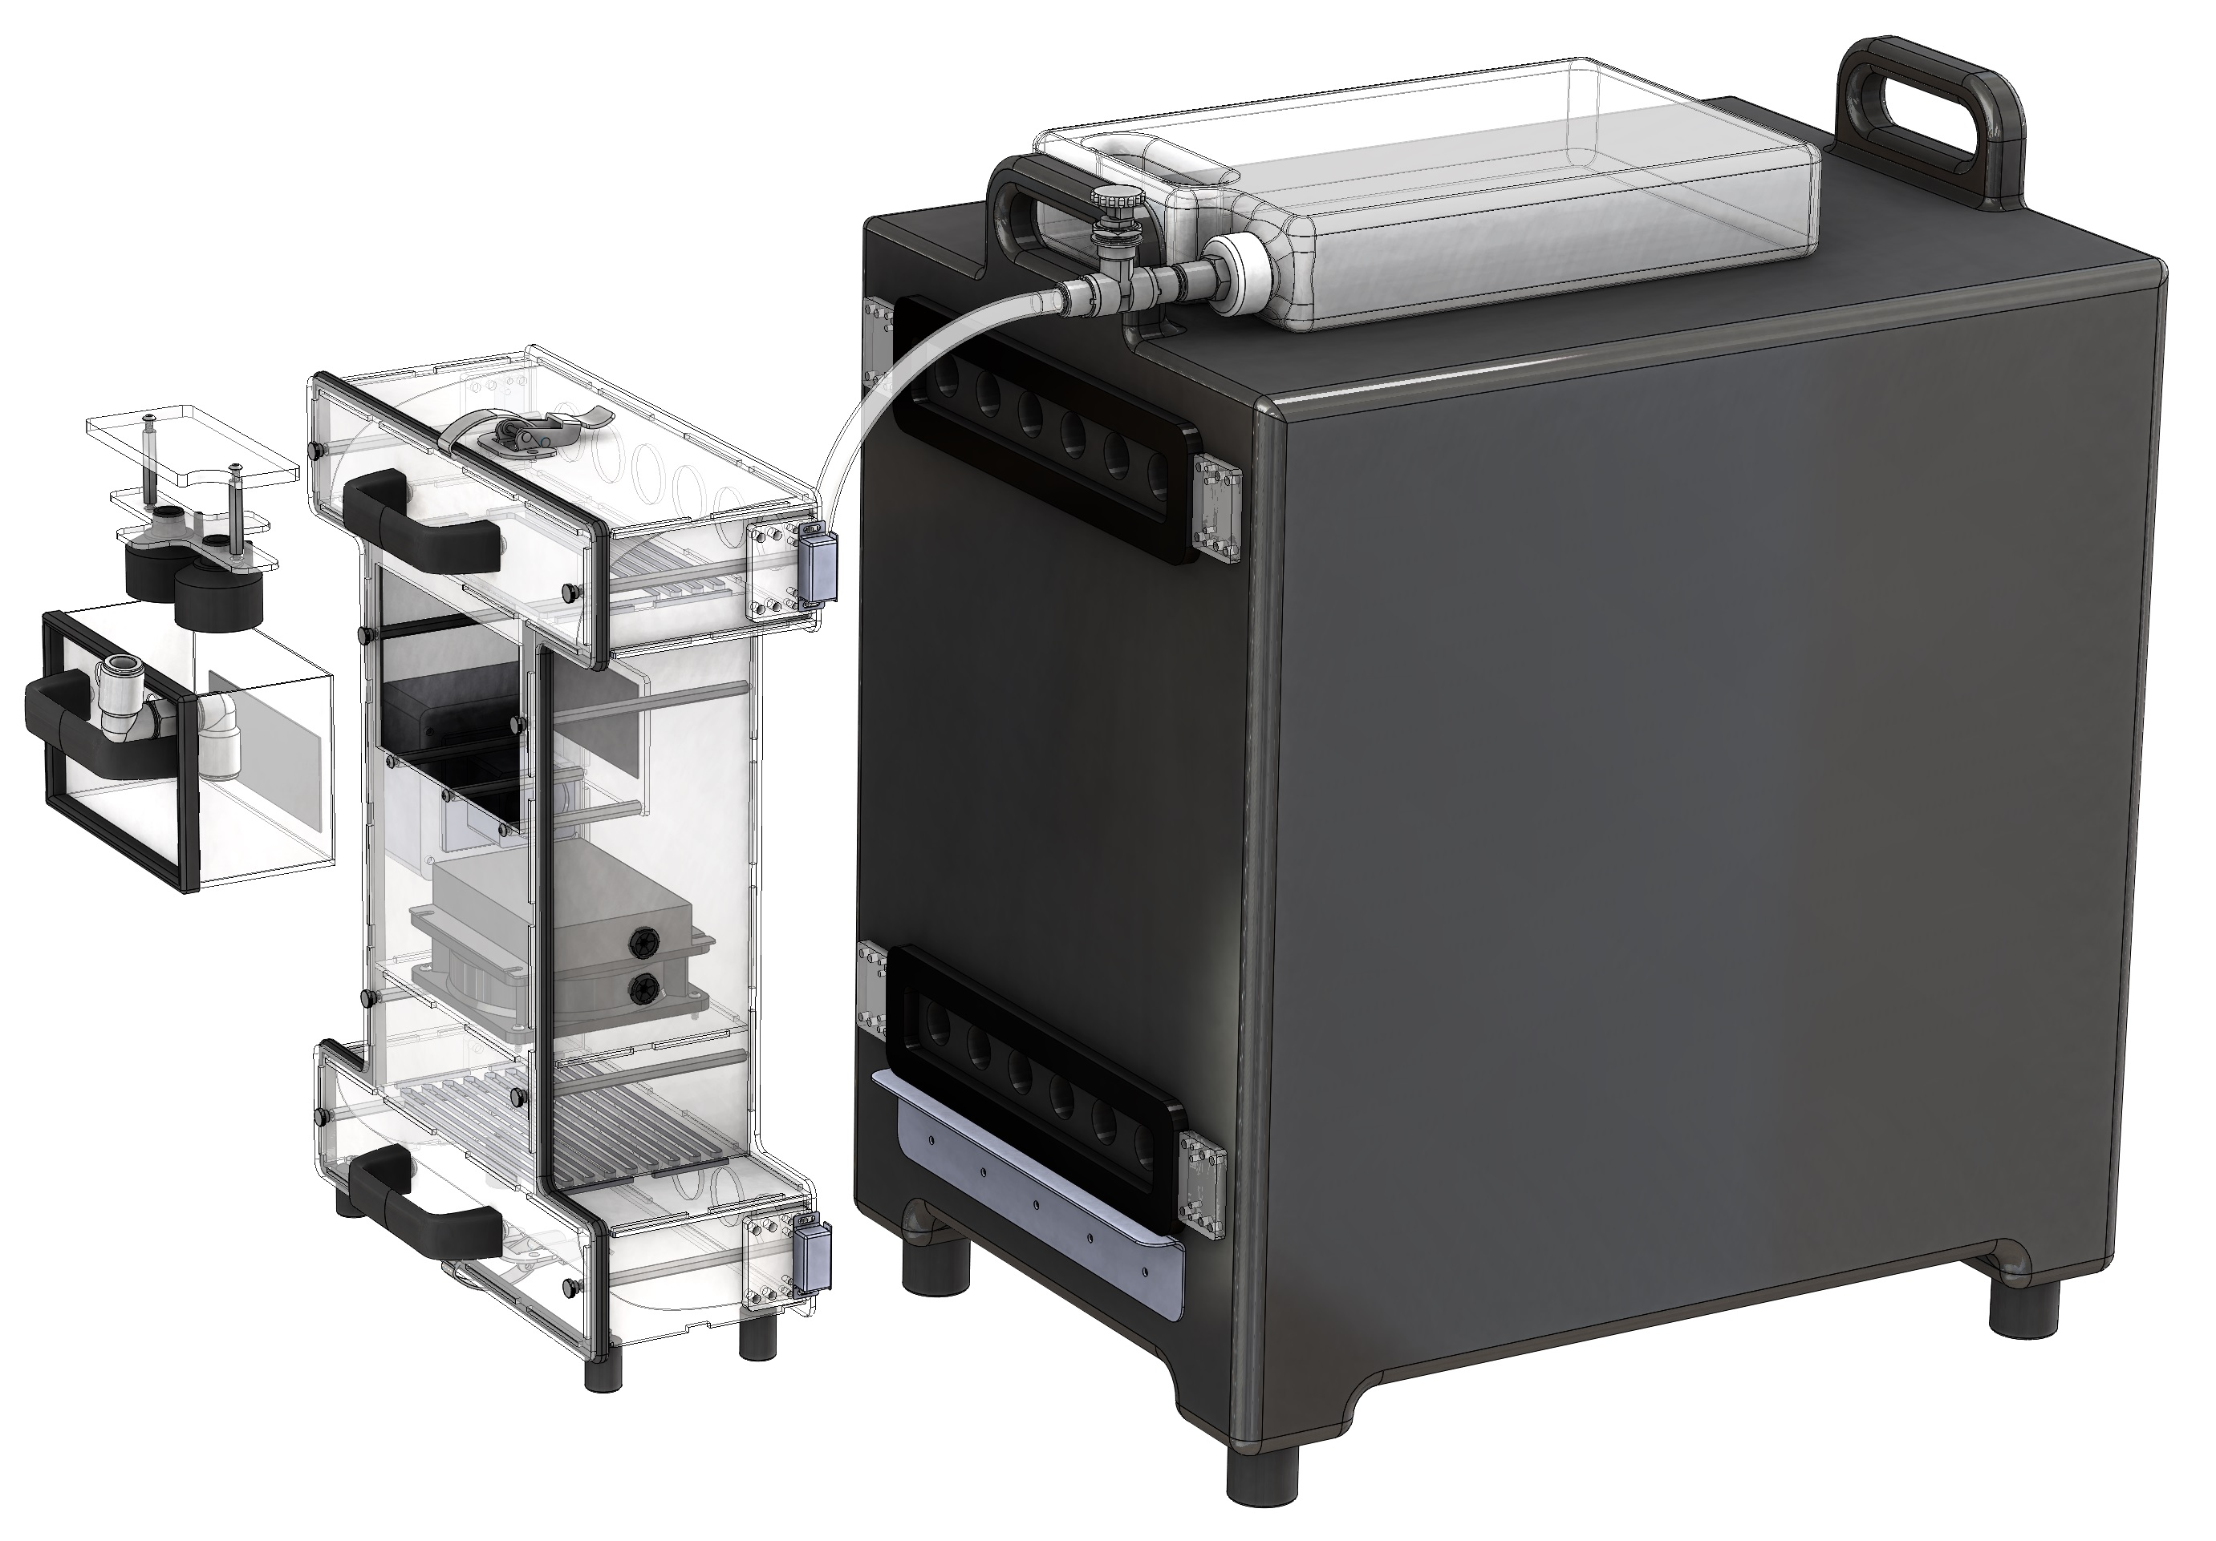
Design Progress
khjkhgj
Asdads
asdad

Slide 8
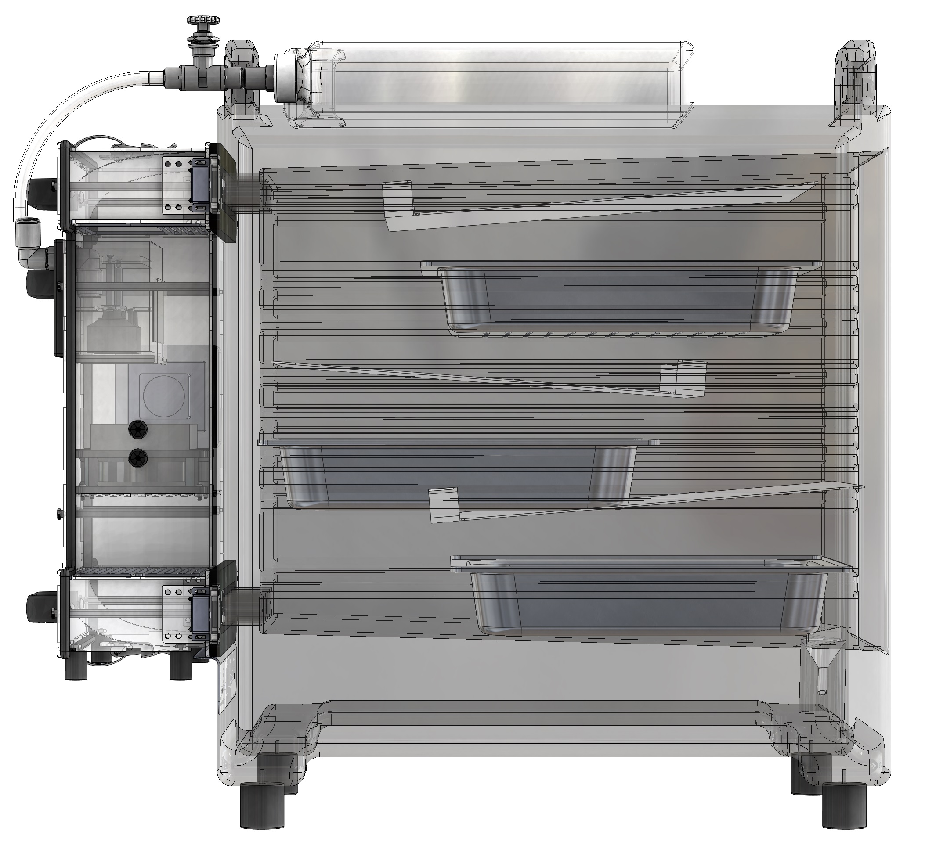
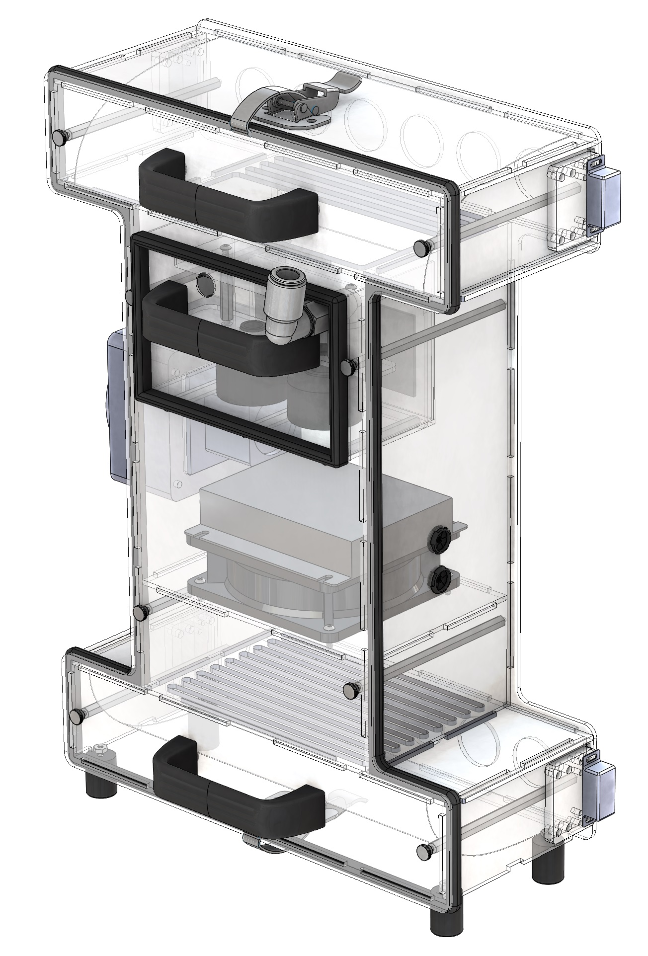
Design Progress
sdfgsdg
Asdads
asdad

Slide 9
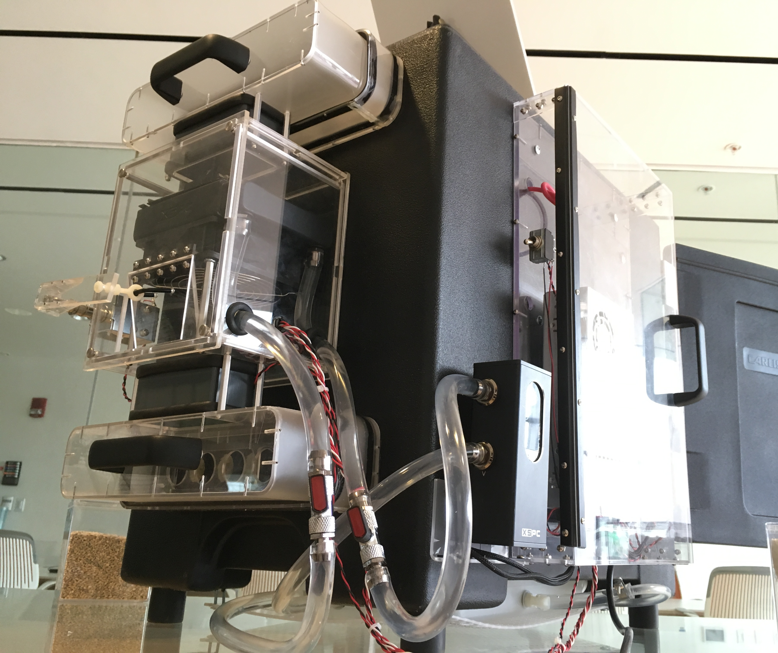
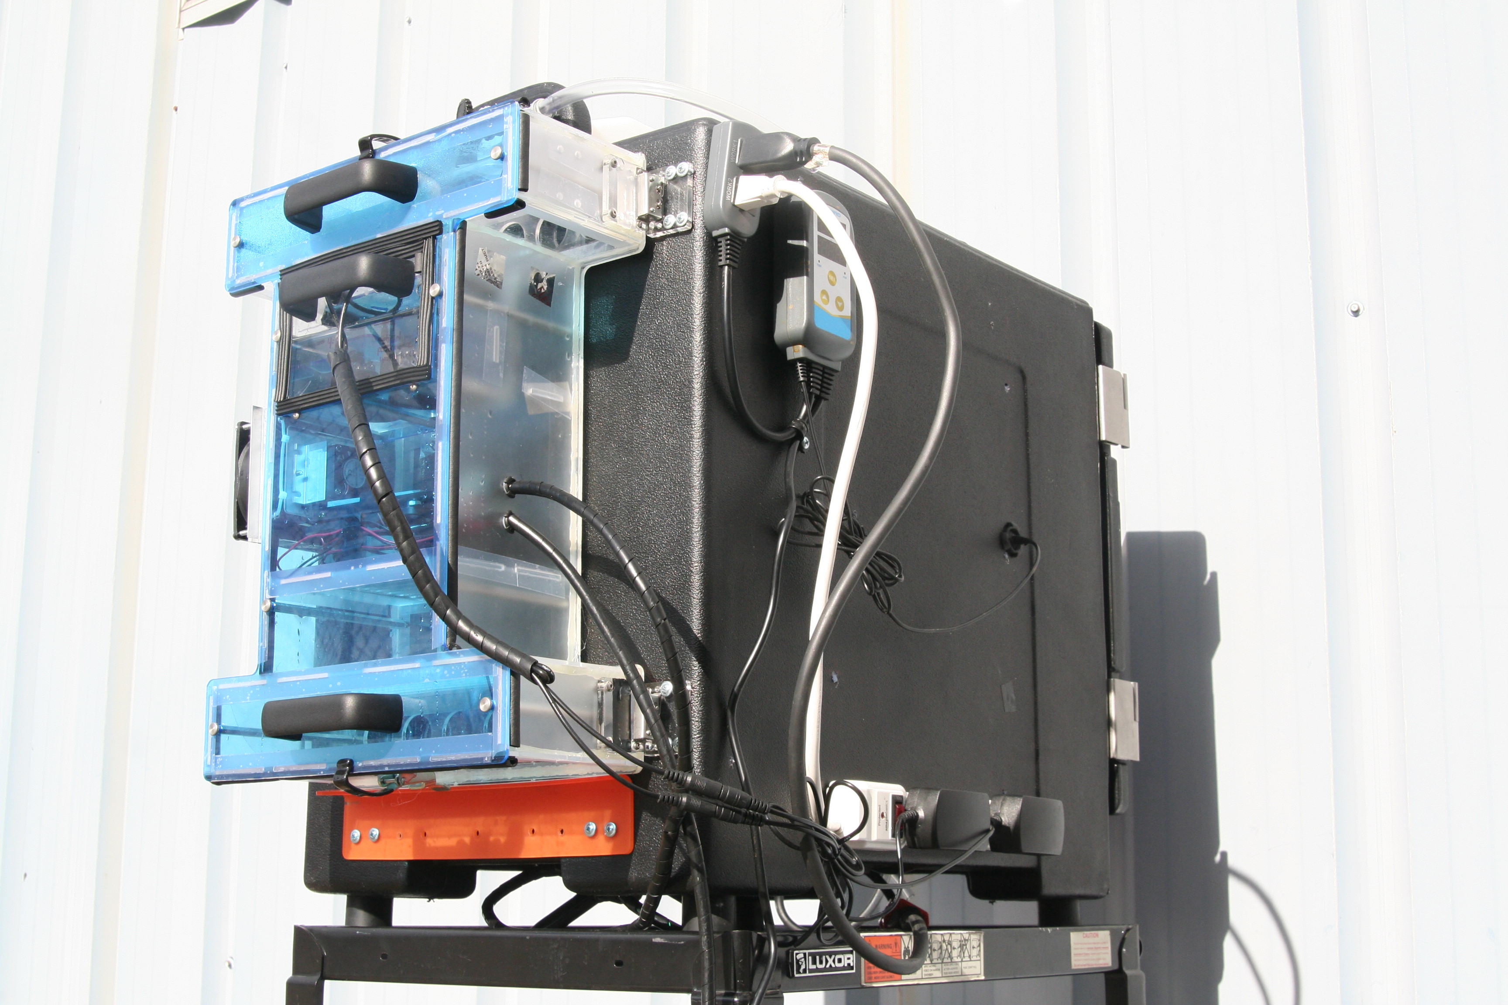
Design Progress
dfgsdfgChamber sdfgsdg
Asdads
asdad

Slide 10
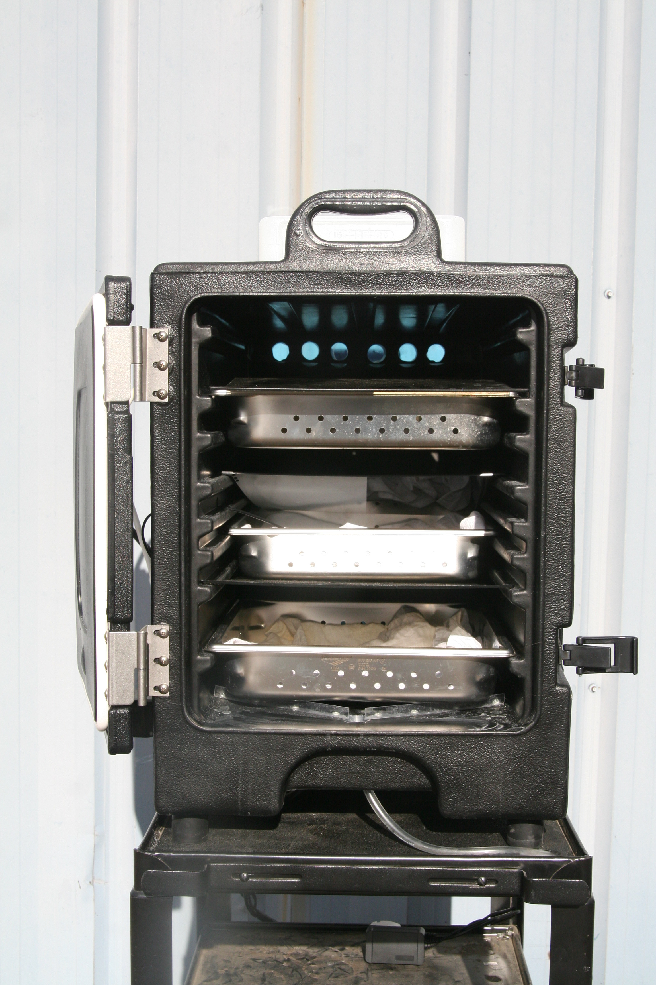
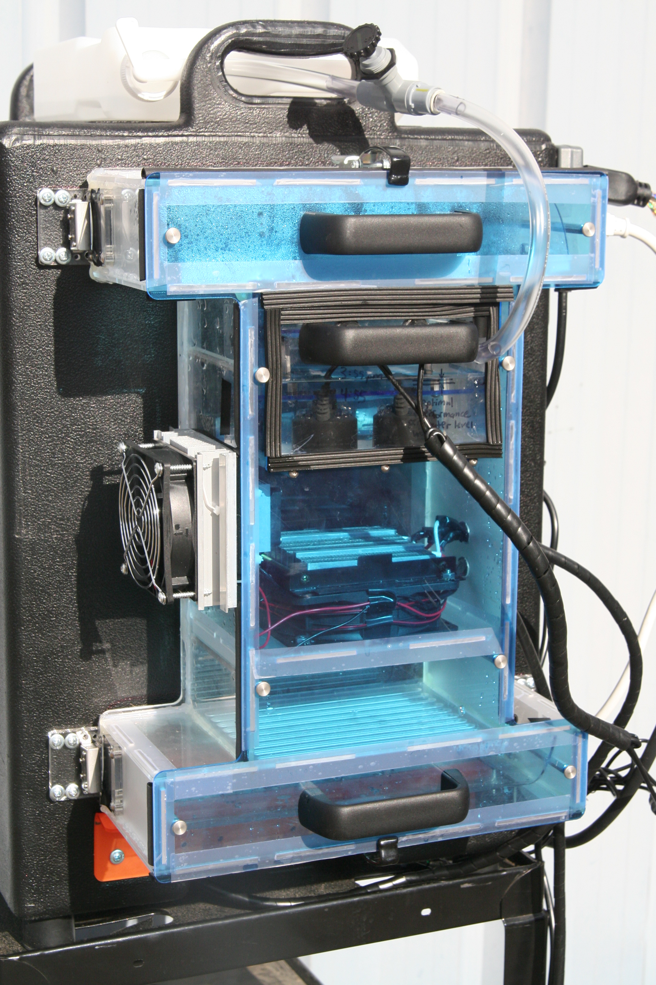
11
10
1
6
8
5
9
4
2
3
7
Design Overview
Environmental Chamber
Piezo Cooler
Fan
Heater
Humidifiers
Temp/Humidity Control System (with live readout)
Condensation Exit
Insulated Food Pan Carrier
Food Pans (with cloth covers)
Condensation Protectors
Humidifier Unit Refill Reservoir

Slide 11
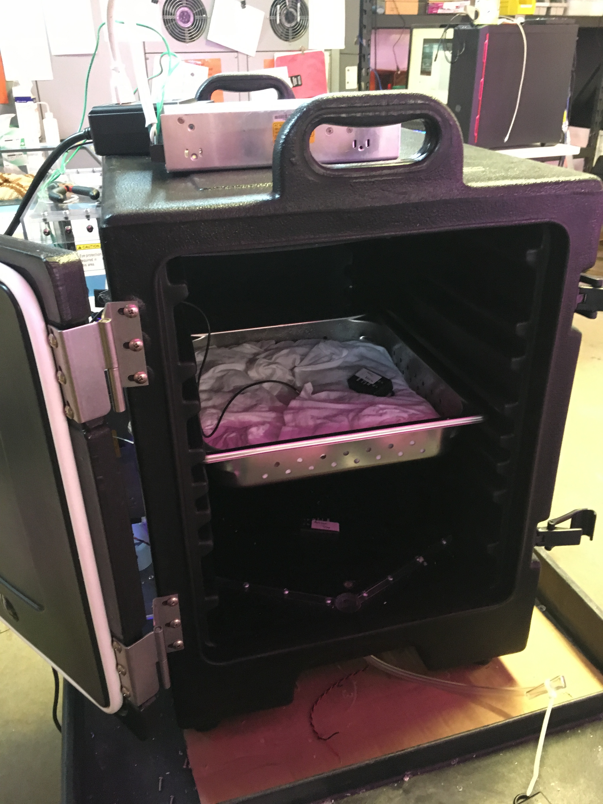
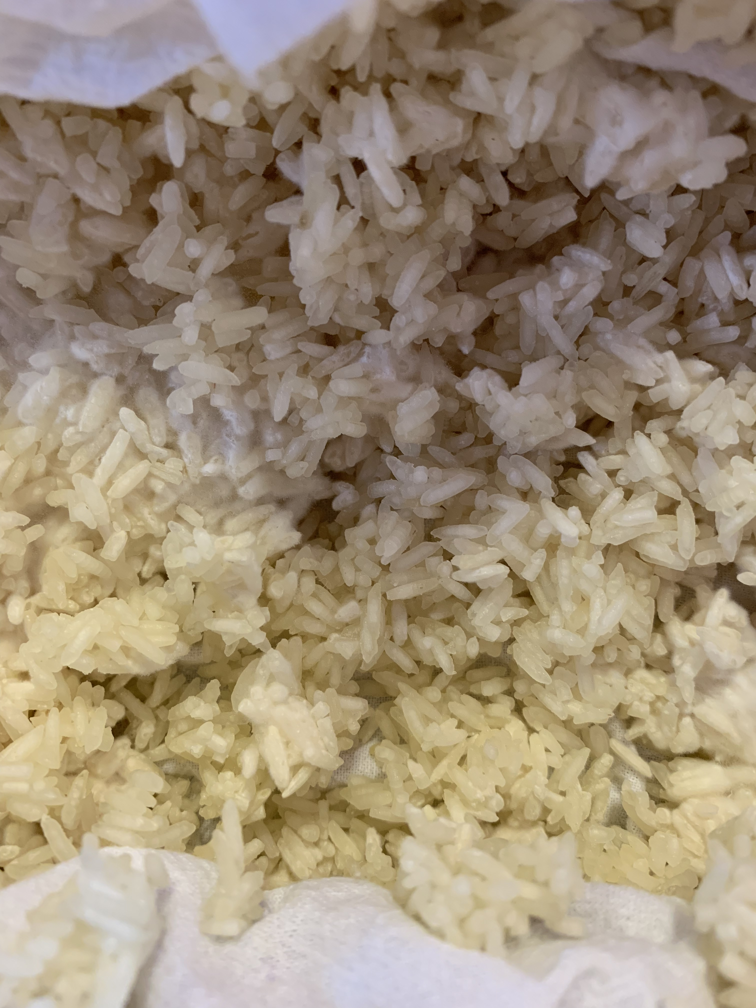
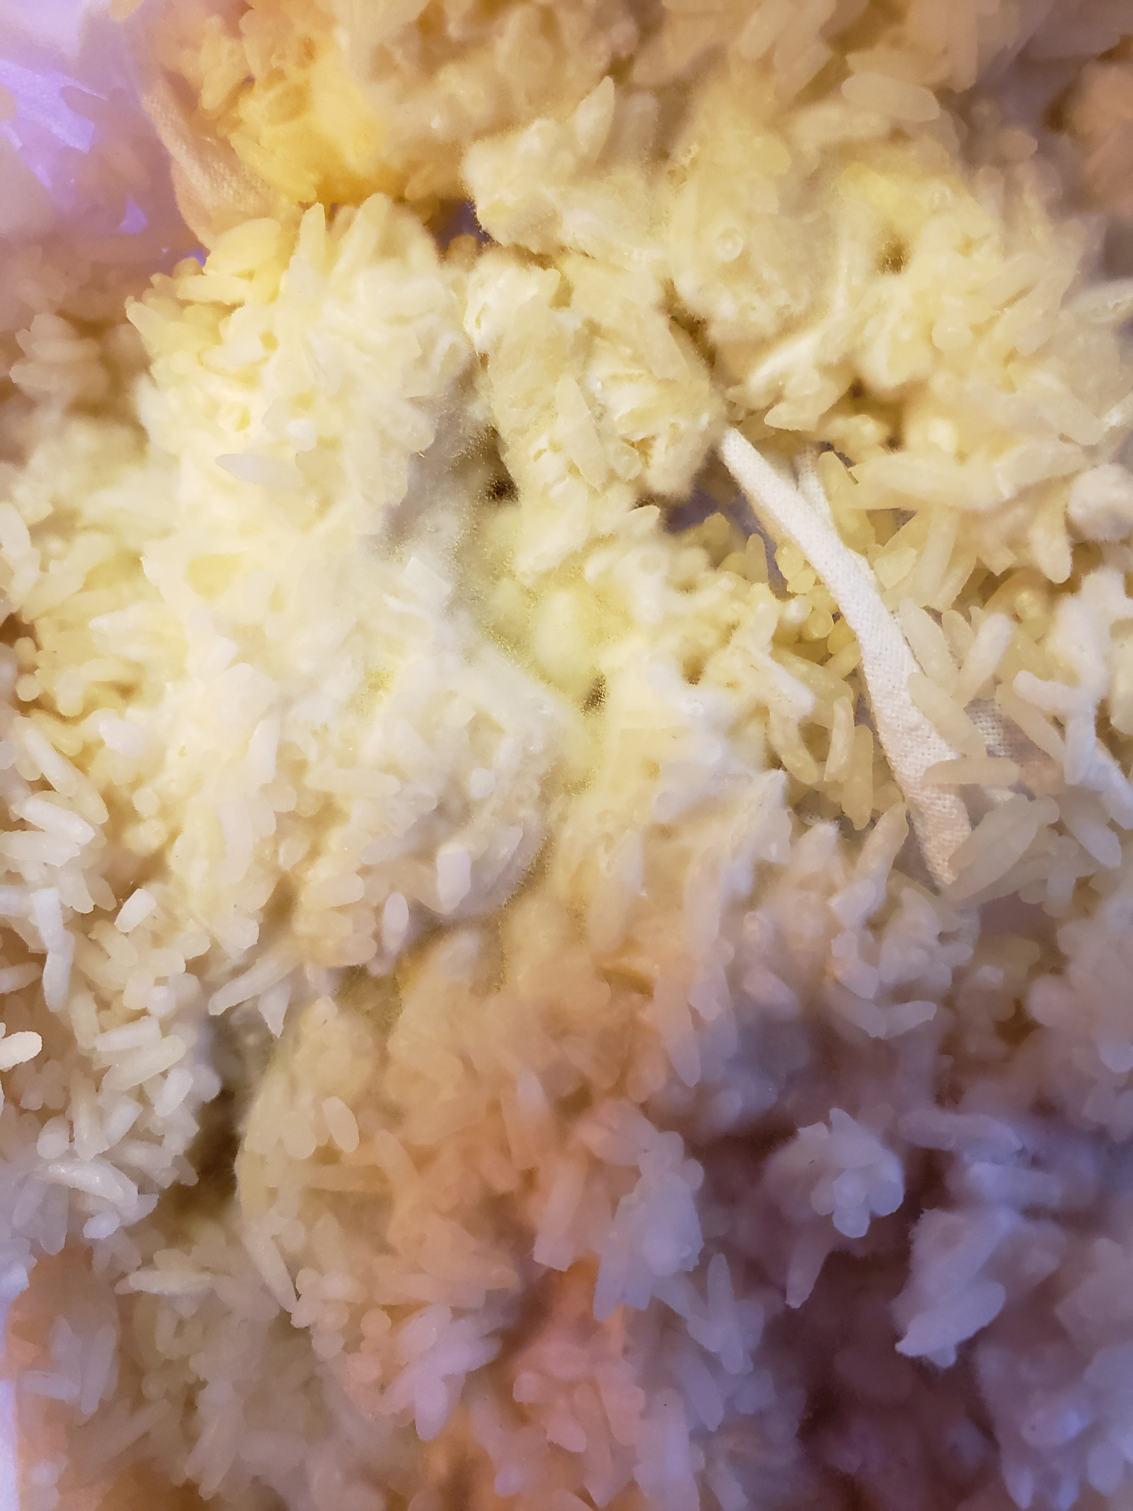
Testing Results
Koji grown successfully at 32°C and 80% RH
Previous control system was unreliable, so only one batch was grown until a better control system could be integrated

Slide 12
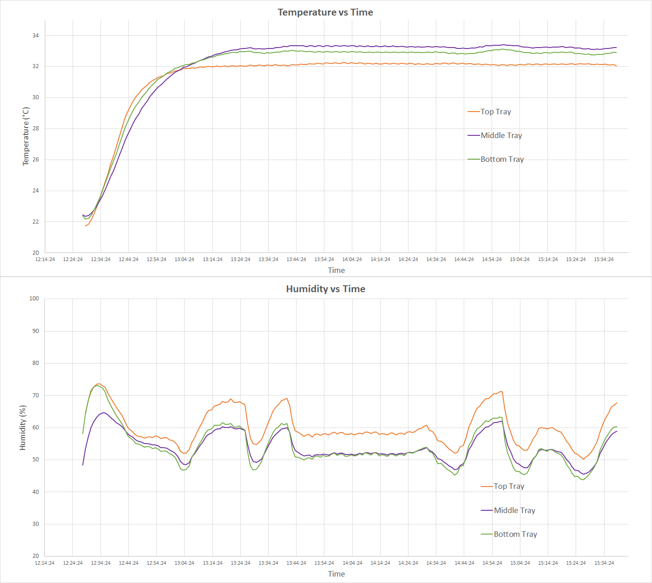
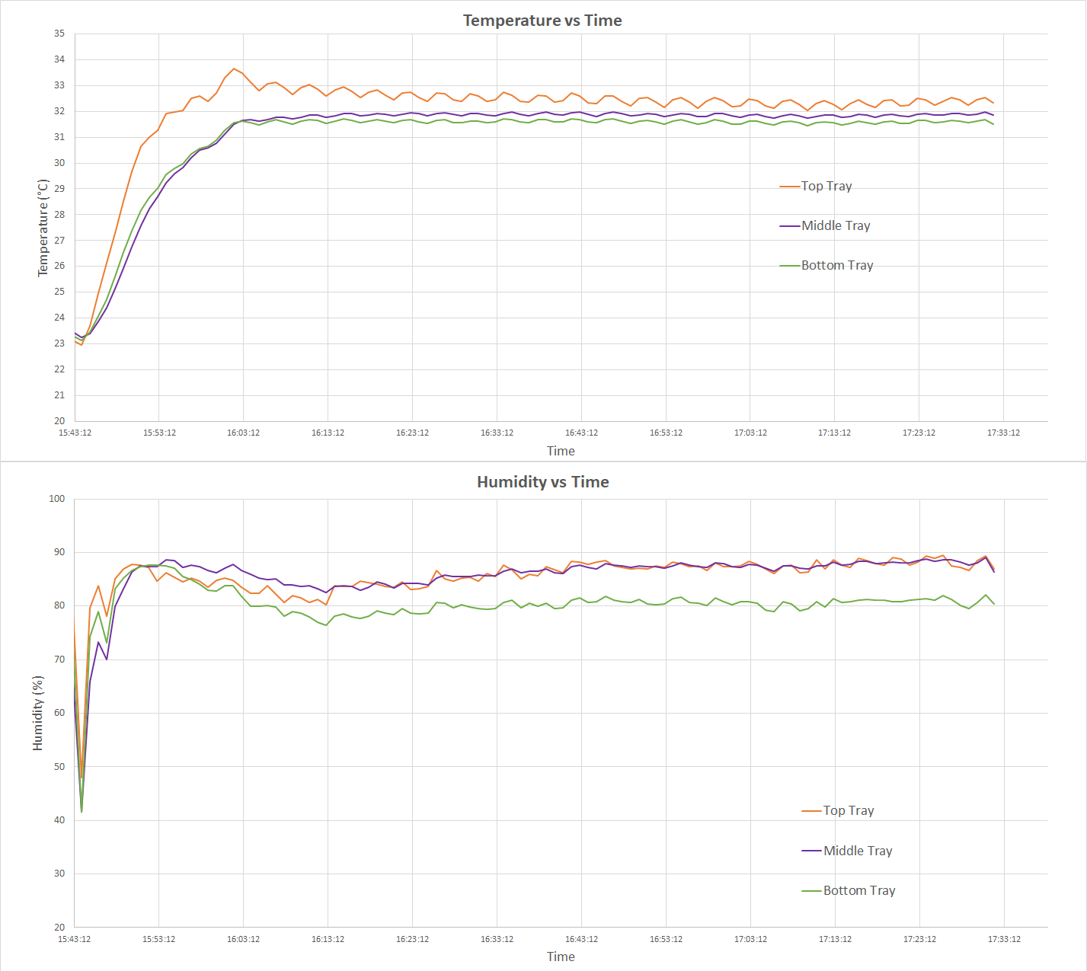
32°C
80% RH
Testing Results
Two hour burn-in tests helped in characterizing the sensitivity of the environmental controls
Location of temperature sensor affected the temp/humidity of each tray
Data collected with Omega OM-92 sensors
Asdads
asdad

Slide 13
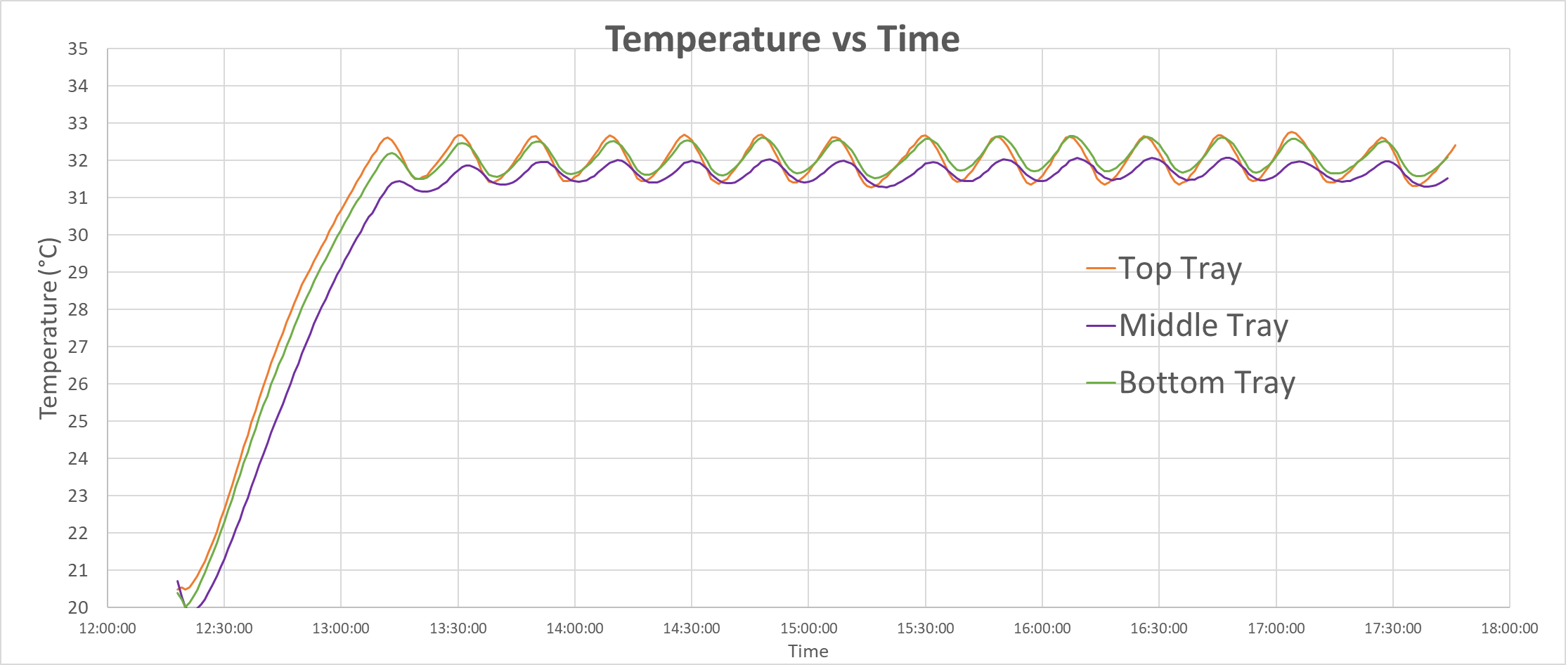
Testing Results
Temperature from 25°C (ambient) to 32°C in approximately 20 minutes
~0.5°C difference between each tray, based on air flow clearance inside
Temperature set to 32°C with bounds at +/-1°C
Adasd
Asdads
asdad

Slide 14
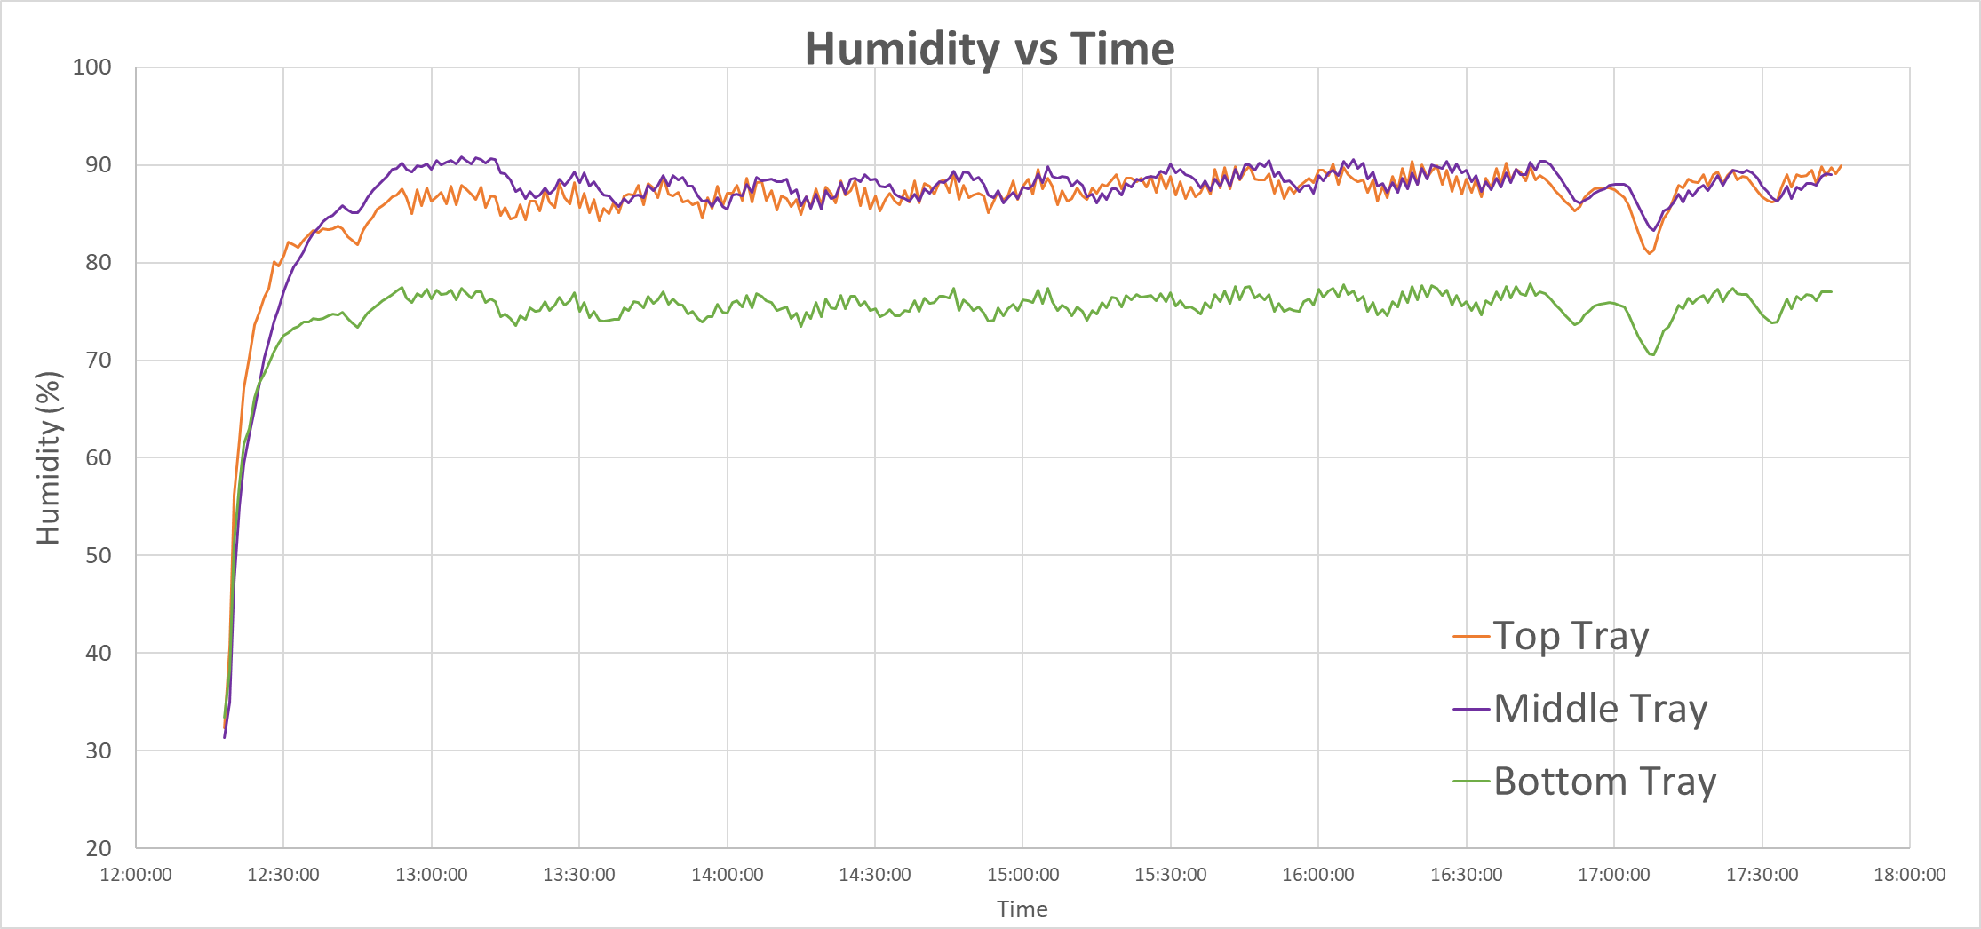
Testing Results
Humidity from 50-60% RH (ambient) to 80-90%RH in approximately 10 minutes
~10%RH variance between the top and bottom tray, based on air flow clearance inside
Humidity set to 80.5%RH +/- 1%
Bottom tray feels least amount of humidity, most likely due to bottom-most Condensation Shield (more testing necessary for optimization)

Slide 15
Budget and Next Steps
Approximately 25% of the Fermentabot Project budget has been spent developing a fully functioning prototype
This includes 3D design, documentation, fabrication, assembly, and mechanical testing o two prototype Fermentabot units (1.1 and 2.0)
Next development steps include
Improving mechanical seals on Environmental Chamber
Improving humidification unit water refill system
Software and hardware development
Creating, fabricating, and testing a circuit board
Creating an online user interface that can control the Fermentabot and collect data via wi-fi
Integrating the software/hardware development into the existing Fermentabot prototype
TOTAL MATERIAL PURCHASES: | $ 2,160.93
Hours Worked (Eugene) (approx. 4.75 full time weeks) | 187
TOTAL LABOR: | $ 5,610.00
TOTAL BUDGET SPENT ON FERMENTABOT: | $ 7,770.93

Slide 16
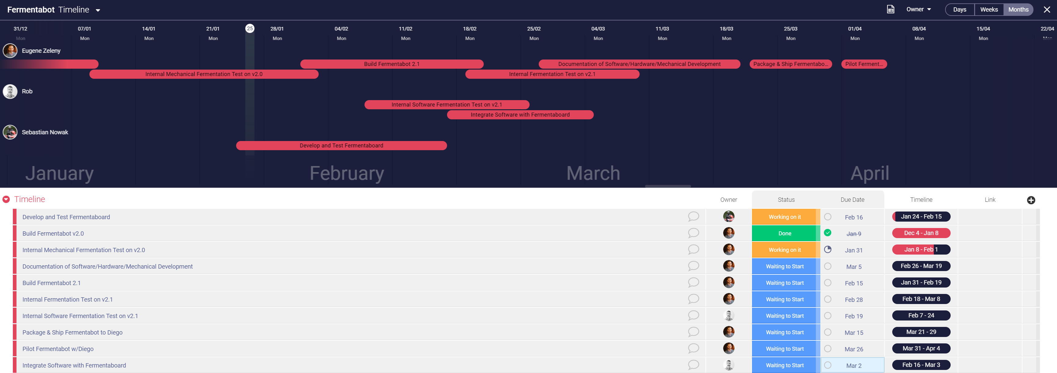
Timeline Breakdown
Koji grown successfully at 32°C and 80% RH
Previous control system was unreliable, so only one batch was grown until a better control system could be integrated

Slide 17
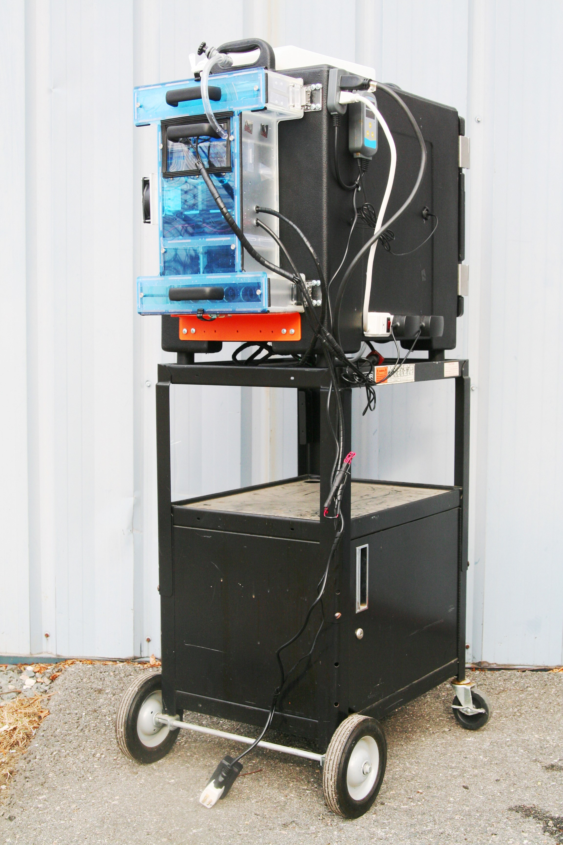
Options for Next Development Steps
No software integration:
As it stands, this Fermentabot prototype is a plug-and-play device – if you plug it into the wall, it will run a single recipe (32°C, 80%RH), until you unplug it, without any software
Copies of this prototype can be fabricated and sent to Diego ahead of the previously described timeline
Software integration:
Creating the PCB, online user interface, and software for running the Fermentabot will give users more control over recipe creation and data collection.
Timeline will reflect previous slide

Slide 18
Thank You.

